Slide 1
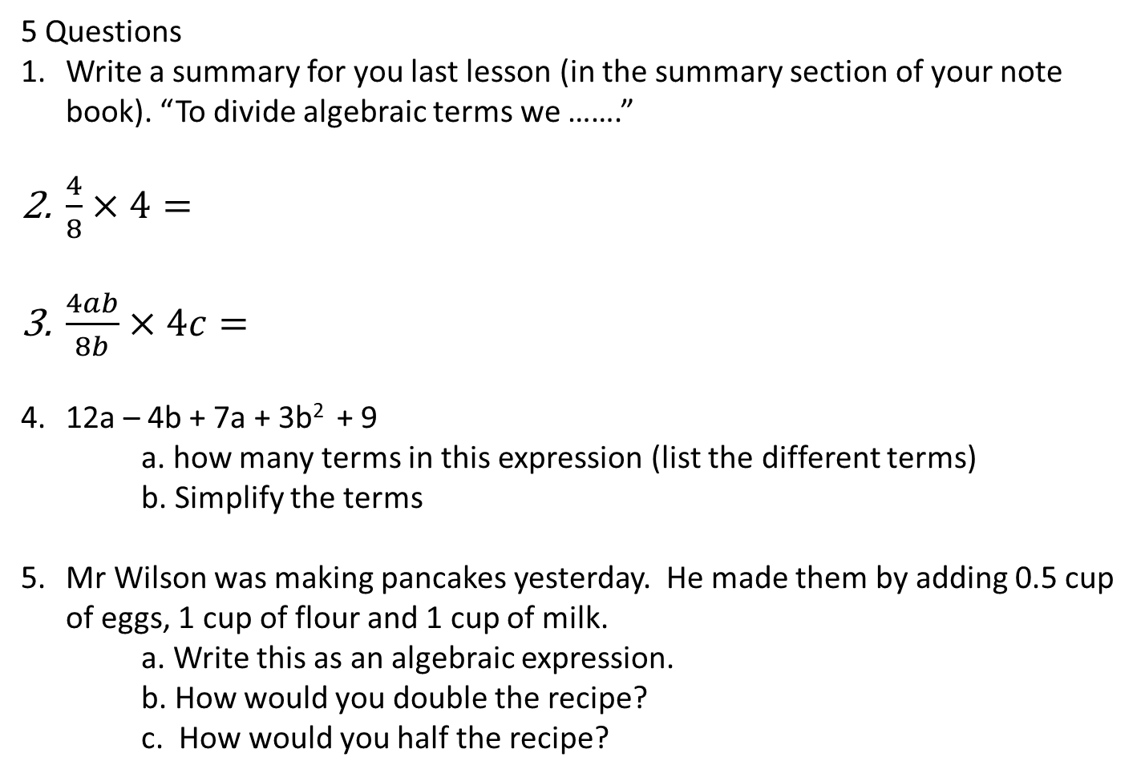
5 Questions
Write a summary for you last lesson (in the summary section of your note book). “To divide algebraic terms we …….”
$\frac{4}{8}×4=$
$\frac{4ab}{8b}×4c=$
12a – 4b + 7a + 3b² + 9
a. how many terms in this expression (list the different terms)
b. Simplify the terms
Mr Wilson was making pancakes yesterday. He made them by adding 0.5 cup of eggs, 1 cup of flour and 1 cup of milk.
a. Write this as an algebraic expression.
b. How would you double the recipe?
c. How would you half the recipe?
Notes:
hook

Slide 2
Lesson objective
By the end of this lesson you will be able to;
- Expand brackets using a model
Notes:
Lesson

Slide 3
Solve the following?
3 x 14 =
3 x ( 10 + 4 ) =
3 x 10 + 3 x 4 =
3 x ( 7 + 7 ) =
3 x 7 + 3 x 7 =
So what is happening now?
3a x 14 =
3a x ( 10 + 4 ) =
3a x 10 + 3a x 4 =
3 x (7a + 7 ) =
3 x 7a + 3 x 7 =
Be careful – remember the rules for adding like terms for these 2.

Slide 4

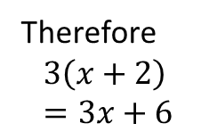
24
7
30
Date
Distributive law
EQ – How can we expand brackets?
Method 1:
Steps
Draw the boxes
Write the terms from the brackets on top
Write the term outside next to the boxes
Multiply the ___ with the ____
Multiply the ____ with the ____
Write your answer nicely
Expand $3\left(x+2\right)$
X 2
3
3x
6
Therefore
$$3\left(x+2\right) \\ =3x+6$$
5
Notes:
Lesson objective (EQ)

Slide 5


Date
24
7
30
Date
24
7
30
Distributive law
EQ –
How can we expand brackets?
Method 2:
Steps
Multiply the 5 with the x
Multiply the 5 with the ___
Bring the sign down
Write your answer nicely
Expand $5\left(x−2\right)$
$\left(x−2\right)$
$$5x − 10$$
$$5x−10$$
5
5
Notes:
Input

Slide 6
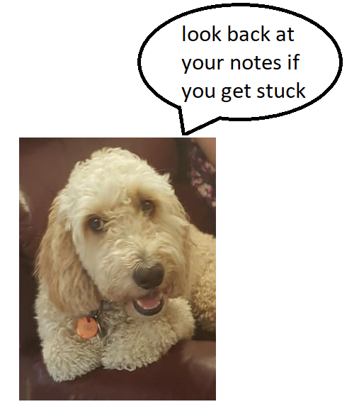
Try these (LHS)
Expand the following
4(d+2)
10(4 - s)
3(2x+7)
Notes:
Check for understanding

Slide 7

Pg 39 Dwyer book
Complete exercise 3.7
If you get stuck
Notes:
Independent practice

